Slide 1


Animation
Chris Piech
CS106A, Stanford University
This is Method Man. He is part of the Wu Tang Clan. ☺

Slide 2

Learning Goals
Feel more confident debugging
Write animated programs

Slide 3
You will be able to write Bouncing Ball

Slide 4
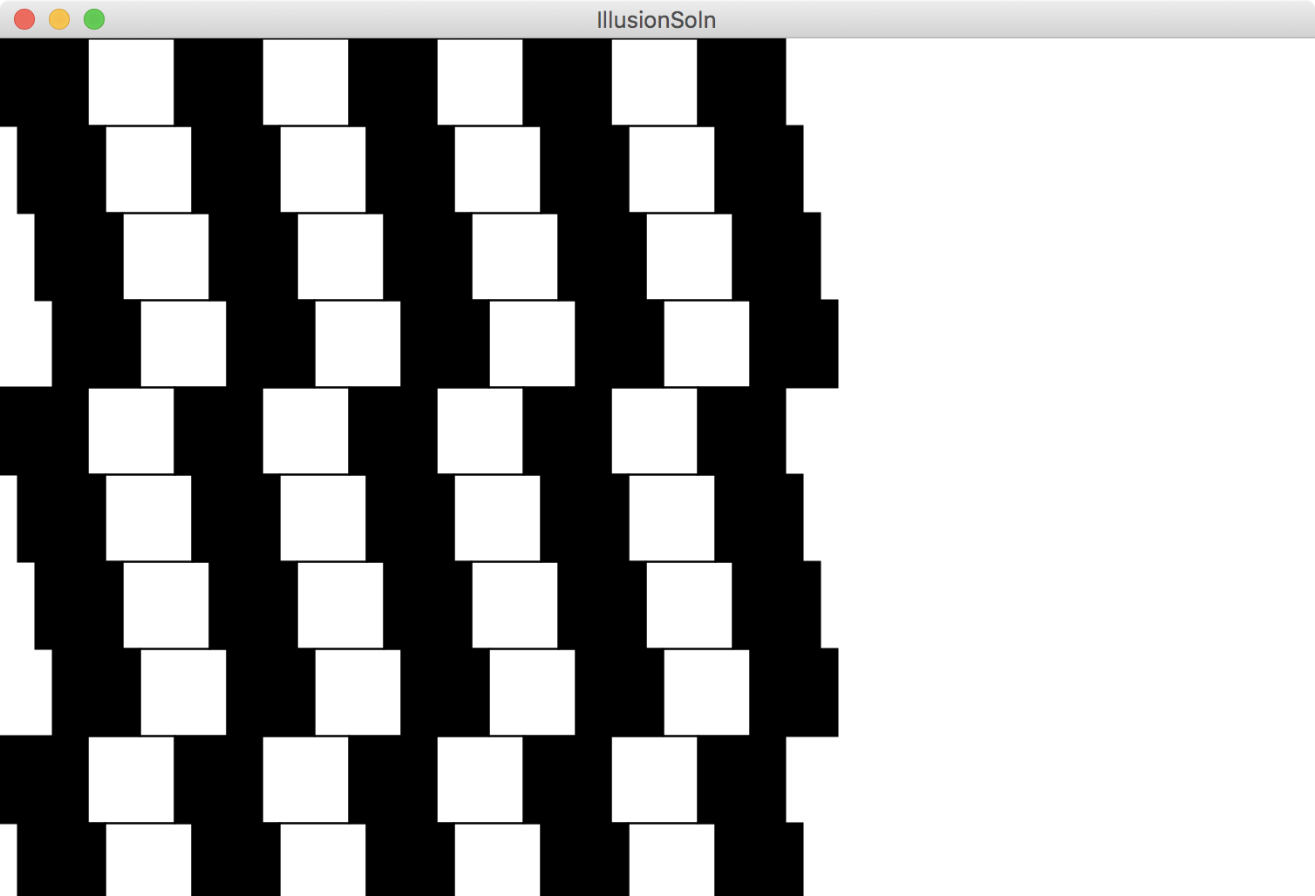

Slide 5
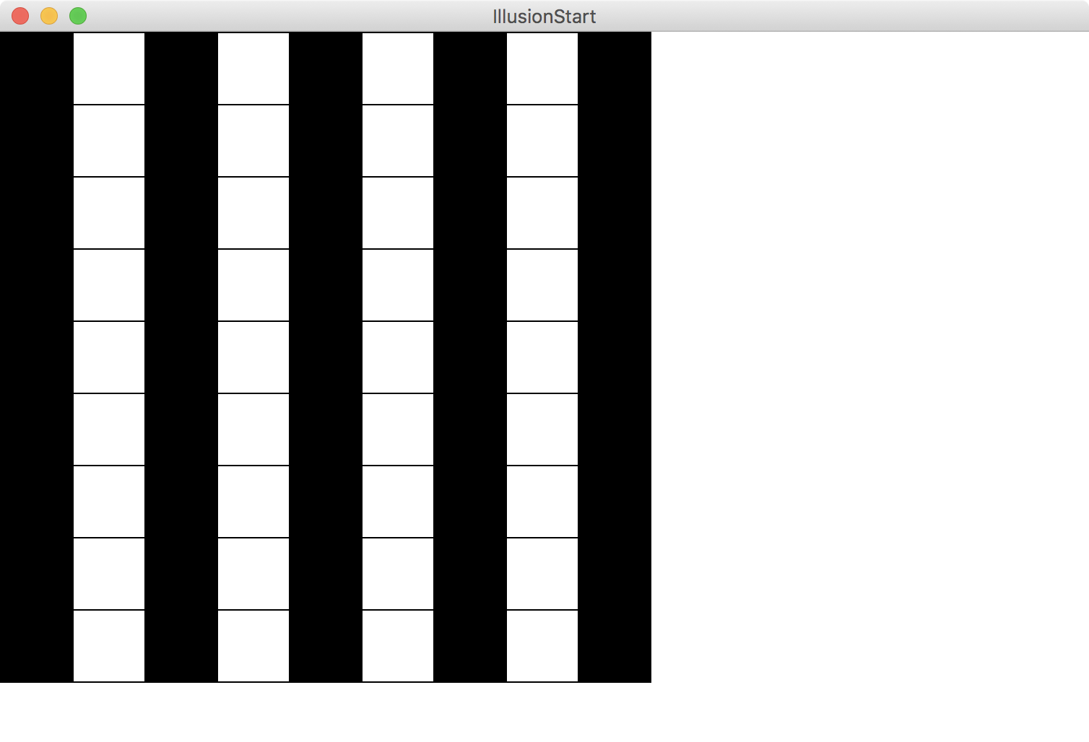
Goal

Slide 6
Great foundation

Slide 7
Move to Center

Slide 8
Animation Loop
private void run() {
// setup
while(true) {
// update world
// pause
pause(DELAY);
}
}

Slide 9
Animation Loop
private void run() {
// setup
while(true) {
// update world
// pause
pause(DELAY);
}
}
Make all the variables you need. Add graphics to the screen.

Slide 10
Animation Loop
private void run() {
// setup
while(true) {
// update world
// pause
pause(DELAY);
}
}
The animation loop is a repetition of heartbeats

Slide 11
Animation Loop
private void run() {
// setup
while(true) {
// update world
// pause
pause(DELAY);
}
}
Each heart-beat, update the world forward one frame

Slide 12
Animation Loop
private void run() {
// setup
while(true) {
// update world
// pause
pause(DELAY);
}
}
If you don’t pause, humans won’t be able to see it

Slide 13
Move To Center
private void run() {
// setup
GRect r = makeRect();
while(!isPastCenter(r))
// update world
r.move(1, 0);
// pause
pause(DELAY);
}
}

Slide 14
Bouncing Ball

Slide 15
Milestone #1

Slide 16
Bouncing Ball
First heartbeat
Velocity: how much the ball position
changes each heartbeat

Slide 17
Bouncing Ball
First heartbeat
vx
vy
The GOval move method takes in
a change in x and a change in y

Slide 18
Bouncing Ball
Second heartbeat
vx
vy

Slide 19
Bouncing Ball
Third heartbeat
vx
vy

Slide 20
Bouncing Ball
What happens when we hit a wall?

Slide 21
Bouncing Ball
We have this velocity
vx
vy

Slide 22
Bouncing Ball
Our new velocity
vy
vx
When reflecting vertically: vy = -vy

Slide 23
Bouncing Ball
Seventh heartbeat
vy
vx

Slide 24
Bouncing Ball
Eighth heartbeat
vy
vx

Slide 25
Bouncing Ball
Ninth heartbeat
vy
vx

Slide 26
Bouncing Ball
We want this!

Slide 27
Bouncing Ball
This was our old velocity
vy
vx

Slide 28
Bouncing Ball
This is our new velocity
vy
vx
When reflecting horizontally: vx = -vx

Slide 29
Bouncing Ball
Tenth heartbeat
vy
vx
When reflecting horizontally: vx = -vx

Slide 30
Bouncing Ball

Slide 31
A Sticky Situation
This is our new velocity
The ball is above the bottom so we reverse its vy
The ball is bellow the bottom so we reverse its vy

Slide 32
Learning Goals
Feel more confident writing methods
Write animated programs

